Slide 1
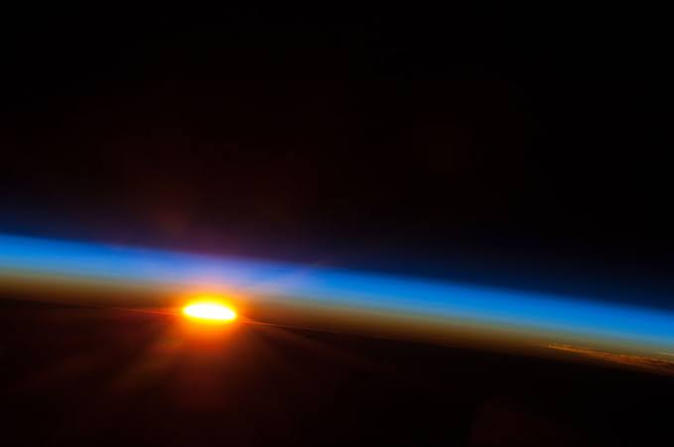
OZONE LAYER 🌏 (Nyati 2&; 08-2021)
A nutshell 🌰
thin layer of O₃ gas present in the upper atmosphere
- shields the Earth from ultraviolet rays

Slide 2
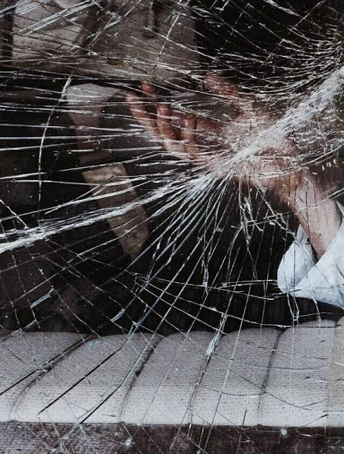
Depletion? 💥💨
agents emitted my human activities e.g.____
some natural causes include the aerosols ejected in volcanic eruptions (enhance chlorine driven destruction)
discovered in the 1970s

Slide 3
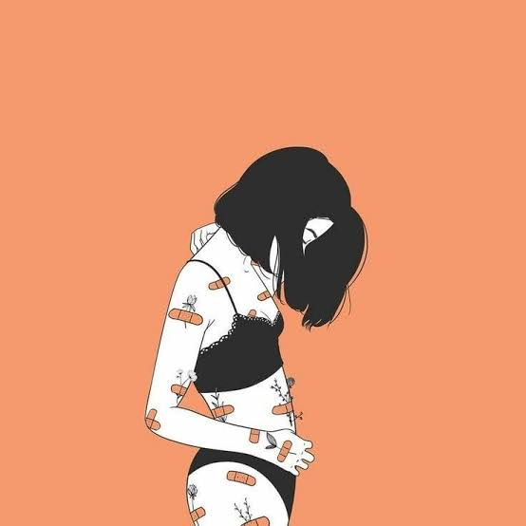
Measures were taken. 🔨
The society has made efforts to restore and preserve the ozone layer by phasing out production and usage of ozone depleting materials like chlorofluorocarbons.
Recovery will be gradual as the substances responsible are projected to linger in the atmosphere for years.

Slide 4
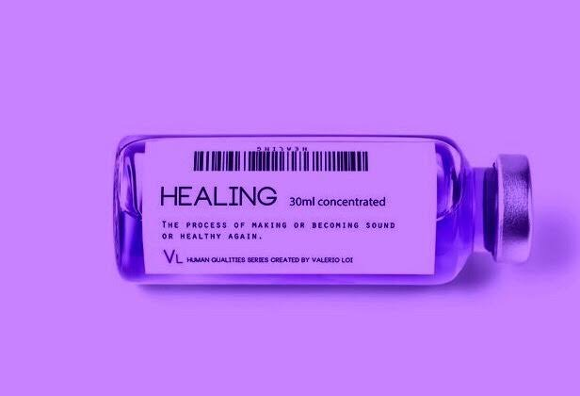
Where are we now? 👙
ozone layer slowly but steadily returning
worldwide efforts are proving fruitful
full recovery not expected until after the second half of this century

Slide 5
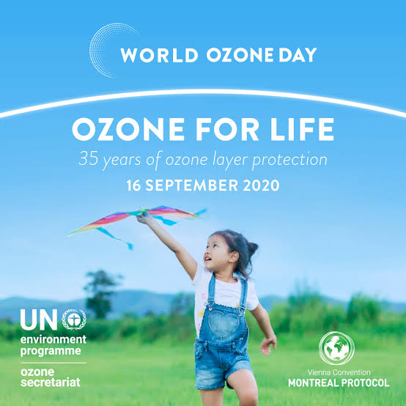
What then? 🙉
Spread awarreness. There are effective protocols already in place. If they are going to work, we must strive to promote their implementation, even in places and contexts where they are disregarded.

Slide 6
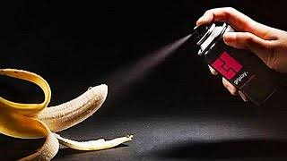
-
Do the little things. Why not just take the initiative ourselves and keep ozone depleting substances at bay? Why not use scented body washes instead of body sprays? Why not carpool to reduce CO₂ fumes in the air?

Slide 7
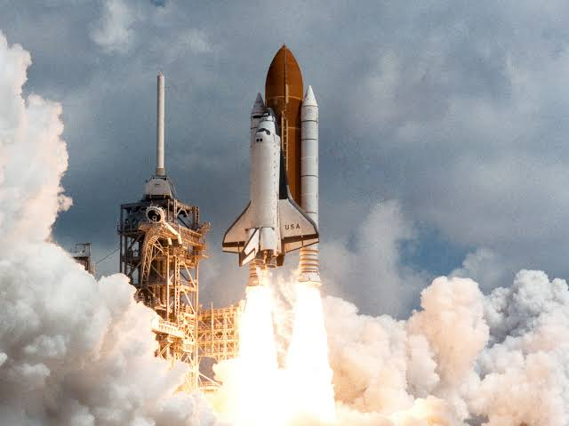
-
Surprisingly, it is also important that we scrutinize new upcoming products and technologies and check to establish the threat they might pose to the ozone layer.
Scientific research and technological advancement are, nonetheless, vital in battling whichsoever monster of nature.

Slide 8

I’m grateful for your attention. 🙇

Slide 9
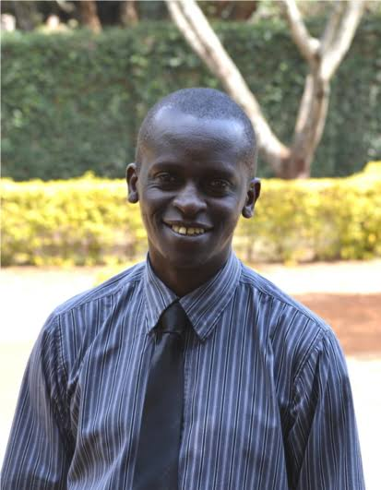
“What do I say to that? NONSENSE!” 👨🏿‍

